Slide 1
Cambridge Summer Institute
Lecture 1: Business Model Development New Products
David Robinson
© D. Robinson, 2018

Slide 2
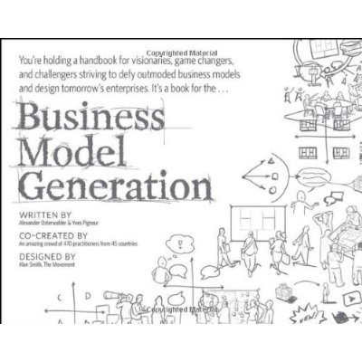
Where the ideas come from (Osterwalder & Pigneur)

Slide 3
Lecture Outline
Quick review of Marketing Strategy
New Product Development (NPD) Process
Lean Startup Movement

Slide 4
Review of Marketing Strategy

Slide 5
The Tenets of Target Marketing
It’s unrealistic to come up with a product that delights all customers
Firms do better when they target a specific group of customers
Narrowly targeted products are more likely to delight customers
We don’t have to have a complicated product to work in several different environments
Channel relations are simpler
Promotion can be more specific

Slide 6
Four Steps to Marketing Strategy
Define the Market
Segment the Market, Choose attractive segments
Design a Marketing Mix to Appeal to the Target
Position our offering

Slide 7
1. Define the Market
Deciding who will buy
Define the Market
Segment the Market, Choose attractive segments
Need our product/service
Have the money to buy
Design a Marketing Mix to Appeal to the Target
Position our offering

Slide 8
2. Cut that Market Up, Choose Attractive Segments
Define the Market
We don’t have to sell to everyone
Segment the Market, Choose attractive segments
Design a Marketing Mix to Appeal to the Target
Position our offering

Slide 9
Possible Dimensions to Segment Consumer Markets
Geographic
Demographics
Income level, age
Psychological
Attitudes, beliefs, personality
Example: “Fashion forward” “Fashion is a waste of money”
Product use
Hobby, on-the-job, special occasion

Slide 10
3. Create a Harmonious Marketing Mix
Define the Market
Marketing Mix
Our mix should appeal to the target
Segment the Market, Choose attractive segments
Product
Price
Design a Marketing Mix to Appeal to the Target
Place
Channel of distribution
Promotion
Position our offering

Slide 11
Promotion
Marketing Mix
Personal Selling
Product
Sales Promotion
Price
Public Relations
Place
Direct Promotion
Social Media
Promotion
Mass Media Advertising
Internet Advertising

Slide 12
4. Position our offering
Define the Market
Chicken/egg problem: Positioning is the result of good strategy, but should guide strategy
Segment the Market, Choose attractive segments
In the minds of customers
Design a Marketing Mix to Appeal to the Target
As compared to competitors’ offerings
Position our offering

Slide 13
Firms that Come up with New Products Beat the Competition

Slide 14
America’s Cup Races, 2013

Slide 15
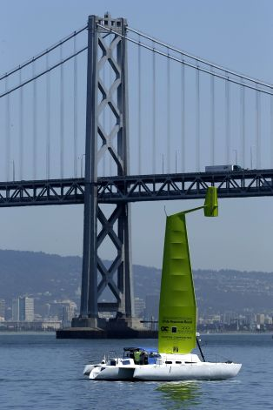
Rich Man’s Sport – or a practical application?

Slide 16
Traditional “NPD” New Product Development
The Conventional Wisdom A well-studied 8-step process

Slide 17
New Product Development
A formal process
If you skip steps you run into trouble
A “key success factor” is understanding the difference between:
Product management for mature products
New Product Development (NPD) ➔ Recognize when the task is NPD

Slide 18
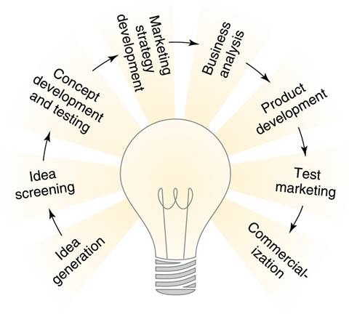
New Product Development Process

Slide 19
1. Idea Generation
Most firms have too many ideas
Old-fashioned view: Find an unmet need
Most often, improvement on something that already exists
What is the unmet need?
What monthly fee would you pay to continue to use Snapchat?

Slide 20
Improvement on something that already exits

Slide 21
2. Idea Screening
Is the technology feasible?
Do we have the design staff
Or, could we contract this?
Do we have the productive capacity?
Can it be built?
Outsource?
Does this fit with our channel of distribution?
What ideas are going to be easiest to sell to consumers?
What is the competitive environment?

Slide 22
3. Concept Development and Testing
Note: The “concept” is just a “concept” (idea)—not necessarily the real product
May get some idea of “WtP” (Willingness to Pay) i.e., target price point
Customers will tell you essential features and performance
Ways to test: Focus groups or structured interviews with
Prototypes (best for tangible objects)
Story boards (good for services)

Slide 23
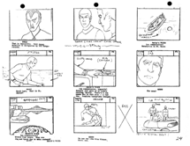
Prototypes & Story Boards
A physical prototype is “this is what it will look like” – it doesn’t actually have to work
We can explain how a service would work

Slide 24
4. Marketing Strategy Development
Define the market
Segment the market
Identify “attractive segments” (and segments to avoid)
Choose appropriate planned positioning
Design all four elements of the Marketing Mix:
Product
Price
Channel of distribution
Promotion
Develop the “pro forma” Income Statement

Slide 25
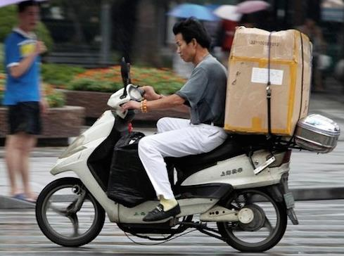
5. Business Analysis
Are we likely to achieve profitability?
Many ideas are abandoned at this point
Channel margins eat up all the profit
Transaction costs kill the idea
Customers are too hard to reach and identify
We would need too large a share of market to cover fixed costs

Slide 26
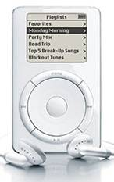
6. Product Development
Technical development of the product
Note this comes fairly late in the sequence
Example: Battery life of iPod “classic”

Slide 27
7. Test Marketing
Need a “closed” market ideally
No leakage of media
Limit rivals’ retaliatory measures
Often an opportunity to test alternatives for:
Positioning
“Suitable for the expert”, or, “everyone can do this at home”
Advertising
Effective media
Nature of appeal: “Tastes great!” “Good for you”
[Industries that don’t do test marketing are “Fashion” industries = throw a lot of things on the shelf, then make more of what sells]

Slide 28
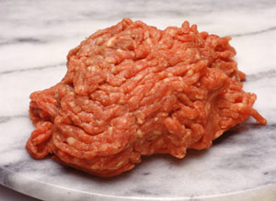
Test Market: Possible Outcomes
Ready for rollout!
Product needs further development
Back to Product Development stage, then re-test
Change any of 4 elements of Marketing Mix
Lack of consumer acceptance
Example: Irradiation for food safety

Slide 29
8. Commercialization (“Rollout”)
Many different ways to do this
Geography
Industry
Medical uses, education
Channel
Photography store, department store
Customer size (“only big accounts”)
Types of user
Specific benefits sought
Example: Speed of shooting, versus faithful color

Slide 30
Summary and Review
Idea generation
Idea screening
Concept testing
Marketing strategy planning
Business case analysis
Product development (technical development)
Test market
Commercialization (rollout)

Slide 31
Idea Generation
Here are some ways that creative teams come up with something new

Slide 32
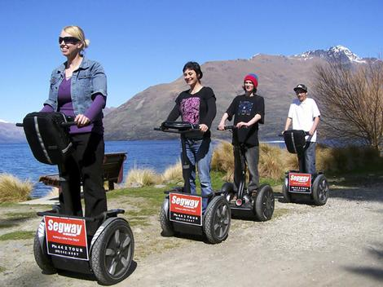
New Offering to a New Market

Slide 33
Modified Offering to a New Market
For the first time, PRC nationals are taking European vacations?
What “product features” would Chinese tourists to Europe demand?

Slide 34
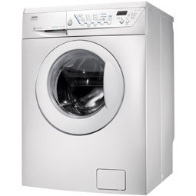
Do Something Better
Make a manual process automatic
Make an automatic process manual

Slide 35
Do Something Better
Value-added to a familiar product

Slide 36
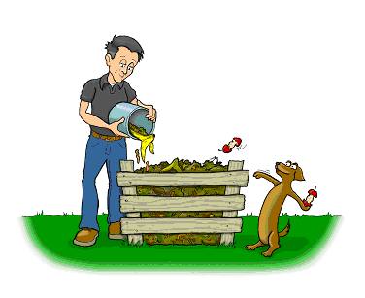
Do Something Better
Biodegradable throw-away utensils
What is the Marketing Opportunity here?

Slide 37
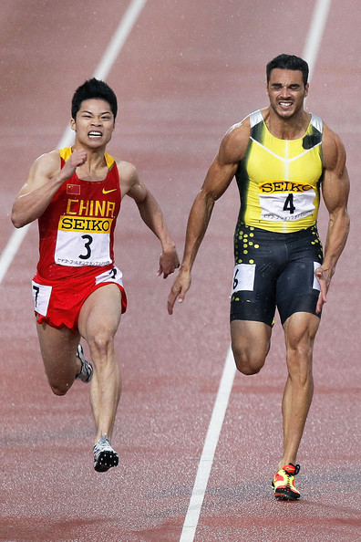
Do Something Faster [Su Bing Tian]

Slide 38
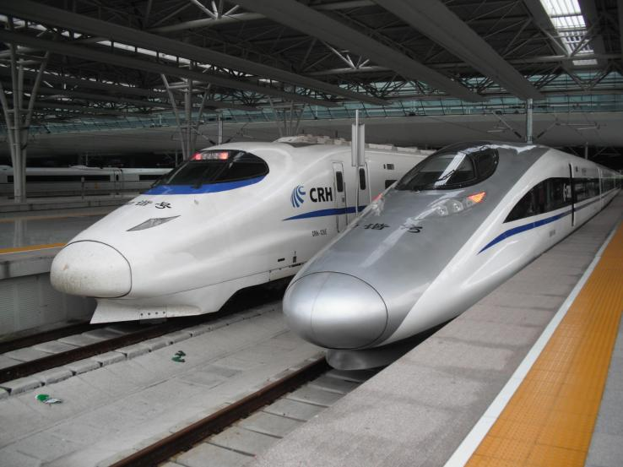
Do Something Faster

Slide 39
Do Something Faster
Pan Am’s China Clipper took 5 days to China

Slide 40
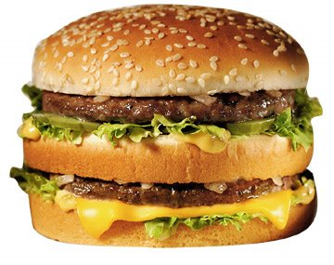
Do Something Slower
The “slow food”
movement

Slide 41
Get People to Do Something for Themselves
Growing tomatoes at home [upside down was a patentable new product]

Slide 42
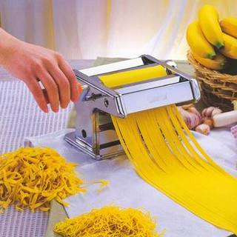
Do Something Themselves
(home pasta maker)

Slide 43
Do Something for People that They Used to Do for Themselves

Slide 44
Do Something for People that They Used to Do for Themselves

Slide 45
Make Something Miniature

Slide 46
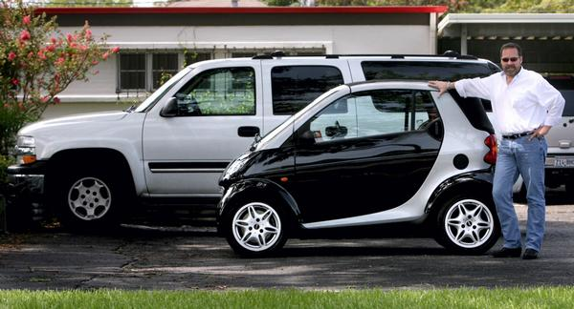
Make Something Smaller

Slide 47
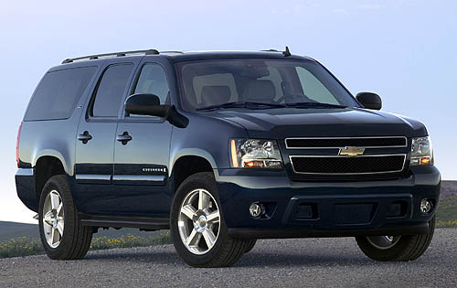
Make Something Larger

Slide 48
Something Bigger

Slide 49
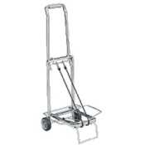
Combine Two Things in One

Slide 50
Combine Two Things in One
Peloton bike

Slide 51
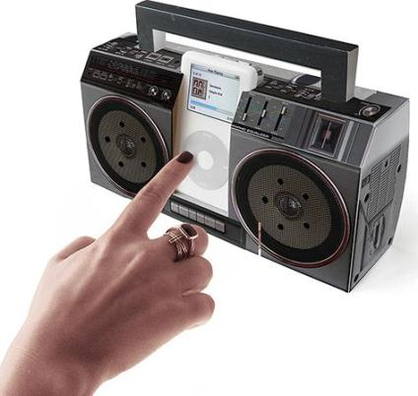
Combine . . . Separate

Slide 52
Summary on Idea Generation
It’s not “random” (waiting for lightning to strike)
Should begin with the core customer benefit
Can involve systematically looking for novel solutions to old problems

Slide 53
Lean Startup Movement

Slide 54
The Lean Startup Movement
Associated with Eric Ries and Steve Blank (teaches @Haas)
Tenets and concepts:
Entrepreneurship is not luck
Minimum viable product
Multiple iterations
Rapid prototyping, A/B testing

Slide 55
The Minimum Viable Product
What is the smallest set of features that an adventurous (tech savvy) user would want?
Facebook early years is a good example
Compare with all you can do on Fb now!
By definition, avoids the “nice to have” for the “must to have”

Slide 56
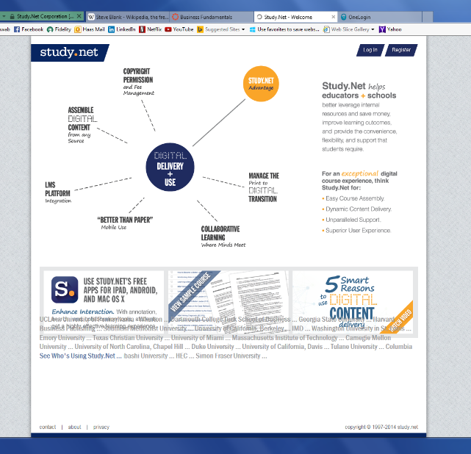
Rapid Prototyping and A/B testing

Slide 57
Consequences of Rapid Prototyping
Many internet firms run dozens of tests each day
The “Product” is constantly evolving
The line between a “prototype” and the actual product is blurred

Slide 58
Additional terms
“Point of Inflection”
When we move from tolerant early adopters to the general population
What changes from a VC point of view
“Pivot”
The business plan suddenly changes
Lyft is a good example

Slide 59
Concept Check: Does the lean startup movement only apply to Internet businesses?

Slide 60
Summary on Lean Startup Movement
Largely embraced as the standard in SiVa (Silicon Valley)
VCs will no longer fund mega-millions for an insanely great idea
The scientific approach to entrepreneurship has appeal
May not directly apply to non-Internet businesses, but may be influential

