Slide 1
Cambridge Summer Institute
Lecture 3: Business Model Canvas Cost Structure; Make/buy/lease & Partners
David Robinson
© D. Robinson, 2018

Slide 2
Lecture Outline
Business Model Canvas: Left hand side
Cost Structure
Make/Buy/Lease decisions
Partners and their functions

Slide 3
The Business Model Canvas
Where’s the agony?
What are the “pinch points”?
What problem does this solve?
The Value Proposition

Slide 4
The Business Model Canvas
Key Activities
The Value Proposition
Key Resources

Slide 5
The Business Model Canvas
Key Partners
Key Activities
The Value Proposition
Key Resources

Slide 6
The Business Model Canvas
Key Partners
Customer Segments &
Attractive Targets
Key Activities
The Value Proposition
Customer Relationships
Key Resources
Channel Relationships

Slide 7
The Business Model Canvas
Key Partners
Customer Segments &
Attractive Targets
Key Activities
The Value Proposition
Customer Relationships
Key Resources
Channel Relationships

Slide 8
The Business Model Canvas
Key Partners
Customer Segments &
Attractive Targets
Key Activities
The Value Proposition
Customer Relationships
Key Resources
Channel Relationships
Cost Structure

Slide 9
The Business Model Canvas
Key Partners
Customer Segments &
Attractive Targets
Key Activities
The Value Proposition
Customer Relationships
Key Resources
Channel Relationships
Cost Structure
Revenue Streams

Slide 10
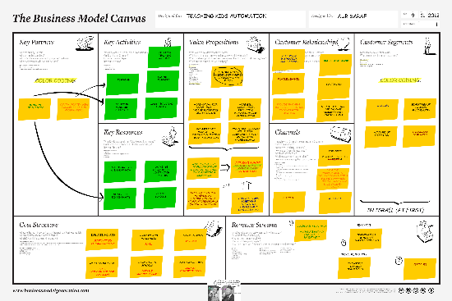
Notes on how to use the Canvas
Make many different versions, iterate
Develop competing alternative models
Combine best features
Draw arrows for relationships
(e.g. outsourcing fulfillment [key partner]eliminates the [cost] of a warehouse)
Use sticky notes, colored pens
Think about the narrative tell a story
You’ll hear the term “persona” = an imagined specific customer: “Shelly wants to get to the airport, but . . .”

Slide 11
[example of “persona”

Slide 12
Cost Structure

Slide 13
The Business Model Canvas
Key Partners
Customer Segments &
Attractive Targets
Key Activities
The Value Proposition
Customer Relationships
Key Resources
Channel Relationships
Cost Structure

Slide 14
Basics
Cost Structure
Fixed costs
Project startup
R&D, development
“Period Fixed Costs”
Office
Warehouse
Core staff
“Overhead” (e.g. business licenses, accounting)
Variable costs
Inputs
Components
Labor
Margins, commission and license fees paid to others

Slide 15
Marginal Cost, Full Cost
What’s the marginal cost for CBL to put on this seminar, given that they are already running courses at Magdalene?
What is the full cost of this seminar?

Slide 16
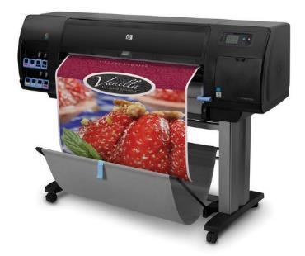
How to win competitive environments
Cost Structure
Sourcing
We have knowledge (contacts, language skills) and can get it cheaper
Radical redesign
Simplify and eliminate parts
“Outsource the work to the customer”
Economies of Scale
Economies of scope
Large companies have in-house marketing research
Cost avoidance:
Outsource just about everything
Example: “AWS” cloud services

Slide 17
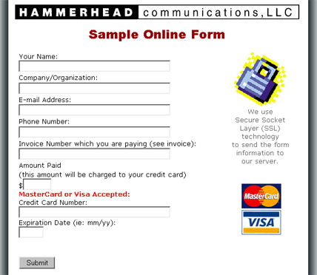
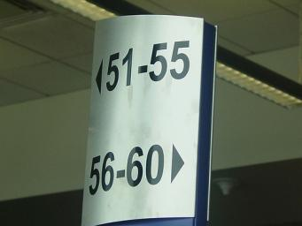
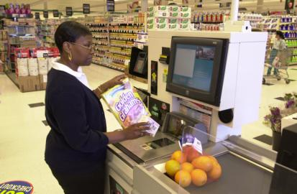
“Outsource the work to the customer”
Self check-out
Southwest’s boarding system

Slide 18
Make versus Buy should be Make, Buy, don’t-buy—lease
Outsource just about everything

Slide 19
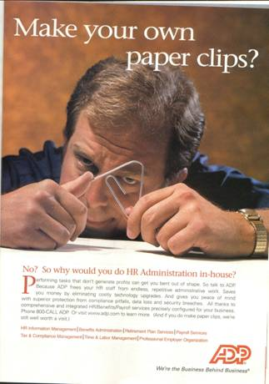
Why should we make anything?
For component inputs
The default should be: buy it in
Only make it in house if you can make it cheaper

Slide 20
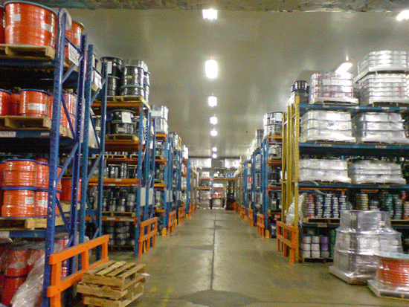
Capital Goods
Why buy it when you can lease it when you need it
Warehouse space
Makes a fixed cost variable

Slide 21
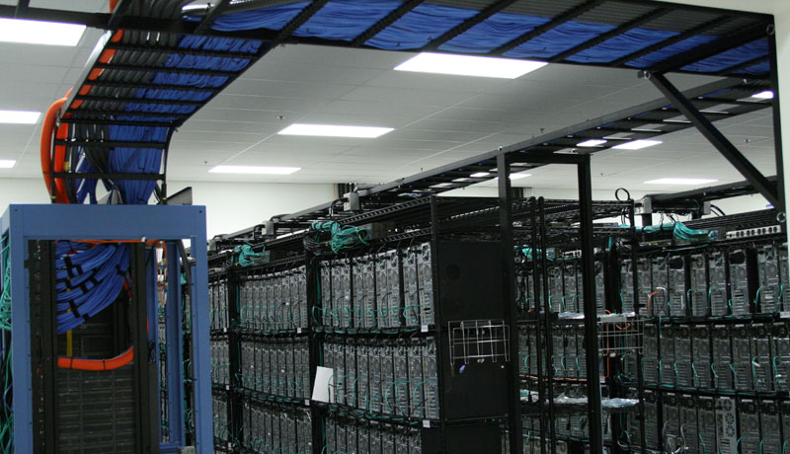
Capital Goods
Why buy servers . . . When you can buy server time by the hour?

Slide 22
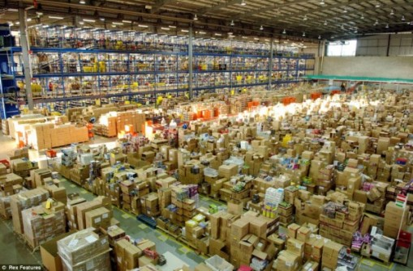
Outsource the whole Function

Slide 23
Why is outsourcing a function cheaper?
The provider has economies of scope and scale
You only pay for what you need
It’s easy to “scale up” without increased capital

Slide 24
So when do we make it ourselves?
Let’s pick that up in the next section . . .

Slide 25
Summary on Cost Structure
Even luxury businesses win by minimizing costs
Look for the cost-advantage
Sourcing
Volume
Challenge every thought to do something in-house
Don’t buy: lease what you need when you need it
Don’t pay for staff: Outsource whole functions

Slide 26
Strategic Partners
Not just “suppliers”

Slide 27
The Business Model Canvas
Key Partners
Customer Segments &
Attractive Targets
Key Activities
The Value Proposition
Customer Relationships
Key Resources
Channel Relationships
Cost Structure
Revenue Streams

Slide 28
Key Activities (where we may need strategic partners)
Design and development
Government regulatory approval
“The platform” (Internet businesses)
Production
Distribution to end user

Slide 29
The Business Model Canvas
Key Partners
Customer Segments &
Attractive Targets
Key Activities
The Value Proposition
Customer Relationships
Key Resources
Channel Relationships
Cost Structure
Revenue Streams

Slide 30
Key resources
Where partners come in: We don’t have to do all this ourselves
Physical
Space (warehouse)
Production facilities
Computing infrastructure
Financial
Capital
Guarantees, risk-sharing
Intellectual property
Patents, licences
Human
Experts, researchers, creative
Workers
Sales force

Slide 31
The Business Model Canvas
Key Partners
Customer Segments &
Attractive Targets
Key Activities
The Value Proposition
Customer Relationships
Key Resources
Channel Relationships
Cost Structure
Revenue Streams

Slide 32
“Make versus Buy” decision When to Make it ourselves
What is the function?
Breaking down our business model into functions
Is it something we can’t do ourselves?
Customs broker
Can they do it better?
Cheaper
Less risk, more reliably
Faster
If they go out of business, raise the price, fail to meet our needs: Are there other equivalent providers? (Examples: Print shop, shipper)
If not, it’s a critical resource (e.g. Facebook’s own servers)
Buy!
Make!

Slide 33
Why Facebook does not outsource its servers
The really do know more about how to run them
The are a power buyer and can buy in bulk
The up-time is mission-critical to FB

Slide 34
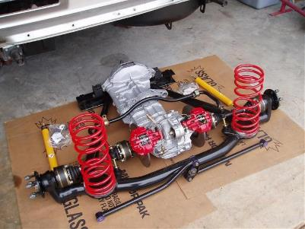
Types of relationships—Traditional
Classic supplier
Integrated supplier
They do sub-assembly
They do development
They do government approval (e.g. food safety)

Slide 35
Types of relationships—Alliances
Strategic alliances (e.g. Fiat/Chrysler)
They have something we don’t
Geographic cross-selling
Joint ventures
Different expertise comes together (PRC, US companies)
Risk-sharing (Samsung-Sony flat panel TVs)
“Coopetition”
Restaurants agree to promote “theater district dining”
Computer firms agree to develop a joint standard for a new chip
The remarkable example of Netflix x AWS

Slide 36
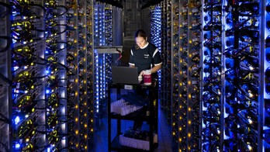
Coopetition at Netflix x Amazon Web Services
95 percent of Netflix movies are streamed from Amazon’s Servers
Netflix’s main US competitor is . . . Amazon
Are they crazy?
What does Netflix get out of this?
Why would Amazon do this?

Slide 37
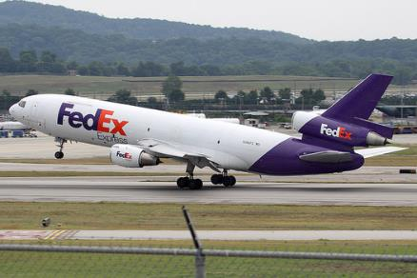
Coopetition /2 FedEx <> US Post Office
FedEx can ship things across country easily (they have lots of planes)
The expenses of the last mile “kill” them
The US Post Office must go past every house, every day
But, they are losing money . . .
FedEx Smart Post uses USPS letter carriers for the “last mile”

Slide 38
Coopetition Example | Funk Rock Band

Slide 39
Coopetition is tricky to manage
Avoid illegal collusion on
Price
Blocking market entry by competitor
Eliminating competitors by unfair means
Understand your “Points of Difference”
Emphasize them
If you face direct competition
Meet head on with force or
Move away gradually
Define the boundaries of the cooperation
What do you not discuss?
Make friends
Seek out common interests
Communicate clearly
Public statements beat any charge of collusion

Slide 40
Summary on Resources Partners
Deconstruct the business into functions
Identify key functions to be done in-house
Understand different levels of partnership and the partners responsibilities
Double-check the risks involved and make contingency plans

