Slide 1
Cambridge Summer Institute
Lecture 4: Business Model Canvas
Customer Relations
Revenue Streams
David Robinson
© D. Robinson, 2018

Slide 2
Lecture Outline
Customer side of the Canvas
Customer relationships
  Acquisition
  Types of customer relations
Revenue streams
  Where the money comes into the firm

Slide 3
Customer Relations

Slide 4
The Business Model Canvas
Key
Partners
Customer
Segments &
Attractive
Targets
Key
Activities
The
Value Proposition
Customer
Relationships
Key
Resources
Channel
Relationships
Cost Structure
Revenue Streams

Slide 5
Customer Relations Activities
Customer acquisition
(What is our process)?
Customer relationship management
  Buy more often
  Buy more when you buy
  Buy higher margin goods (“upselling”)

Slide 6
Customer Acquisition
What’s a “non-prospect”?
Prospects
Qualified
prospects
Customers
How do we do each of these?

Slide 7
The Prospecting Sequence
“I’m just visiting for the summer”
Suspect
Prospect
Qualified Prospect
Customer
Loyal
Customer
E.g. “People who live in Cambridge”
“Do you currently have a college savings plan?”

Slide 8
Customer Relations Activities
Customer acquisition
(What is our process)?
Customer relationship management
  Buy more often
  Buy more when you buy
  Buy higher margin goods (“upselling”)

Slide 9
Types of Customer Relationship
Level zero: Transaction based, we know nothing about the customer
  E.g. Customer looks at our website
  Customer purchases through a retailer
  (who purchases from our wholesaler)
Self-service
  Supermarket
Co-creation
  Internet 2.0 e.g. Amazon’s user-written reviews
Personal assistance
  Call center, florist shop
Dedicated personal assistance
  your name identified representative, bank manager
Membership
  Golf club
Increasing cost

Slide 10
Summary on Customer Relationships
We should have a clear plan for:
  Customer acquisition
  Customer relationship management
We should choose the level of customer engagement/customer service as part of our business plan
  Note: High levels of personal service are expensive to our Cost Structure

Slide 11
Exercise: Citi Bus
Levels of Customer Relationship

Slide 12
Channel Relations

Slide 13
The Business Model Canvas
Key
Partners
Customer
Segments &
Attractive
Targets
Key
Activities
The
Value Proposition
Customer
Relationships
Key
Resources
Channel
Relationships
Cost Structure
Revenue Streams

Slide 14
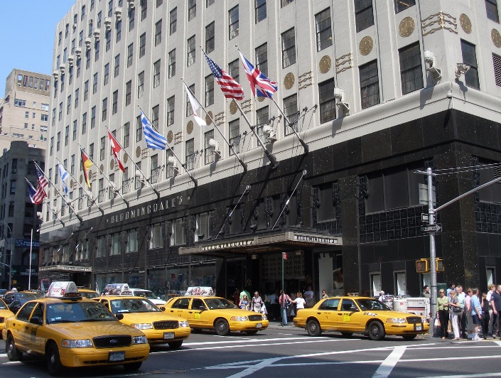
Why we need channel members
Geographic reach
  Availability
Local knowledge
Promotion of our products
  Awareness of new products and services
  Communicating the Value Proposition
Relationship with customers
  Personal (repeat customer)
  Virtual (Yahoo Travel = Travelocity)
Post-purchase support

Slide 15
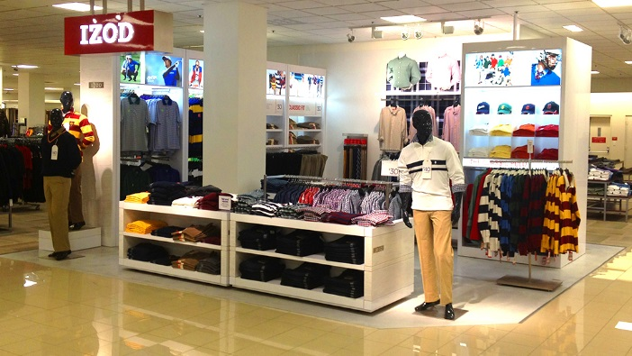
Types of channels
Traditional:
Manufacturer-wholesaler-retailer-customer
  All retailers
  Licensed agents only
  Boutiques within others’ stores (our staff)
  Our own retail stores
Internet ( “direct-to-customer” sales )
  Order-taking
  Order fulfillment
Hybrids:
  Agent sells, we fulfill (Study abroad)
  We sell (our salesforce), buy from their store
This is the new
term of art

Slide 16
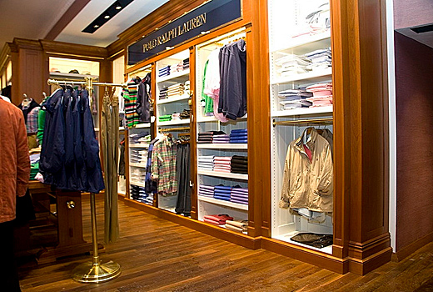
How to choose the type of channel
Desired breadth of geographic distribution
Complementary goods (shirt, tie; pumps, backhoe)
Complementary services
  Training
  Installation
Positioning, image
Costs
  Sell through others: Margin
  Sell ourselves:
  High period fixed costs and startup fixed costs

Slide 17
Summary on Channel Partners
Define the tasks we need the channel to do
Evaluate who will do each function best—
them or us?
Fully cost the alternatives

Slide 18
Revenue Streams
More important than pricing—it’s how we get paid

Slide 19
Lecture Outline
Revenue Streams
  Some Pricing Tactics
Limitations of “free” as a price

Slide 20
The Business Model Canvas
Key
Partners
Customer
Segments &
Attractive
Targets
Key
Activities
The
Value Proposition
Customer
Relationships
Key
Resources
Channel
Relationships
Cost Structure
Revenue Streams

Slide 21
Revenue Models
Begin with the Value Proposition
  What will customers pay for?
Then, how will they pay
In general:
  Transaction
  Subscription
  Third party (especially advertising)

Slide 22
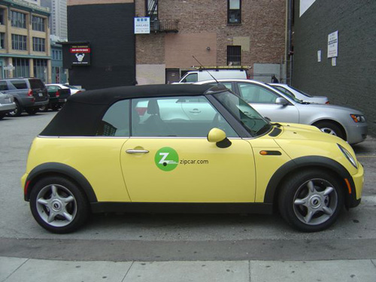
Transactions
Asset sale
  Example, you buy a laptop
Usage fee
  Minutes used on cell phone
Renting and leasing
  Zipcar

Slide 23
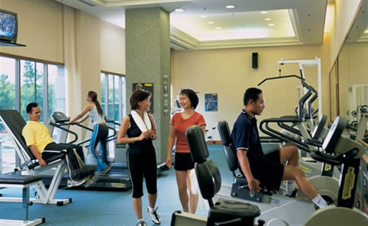
Subscription Models
The paradoxical
problem of
the Subscription Model
Monthly fees independent of usage
  E.g. Netflix, Carbonite
  Gym membership

Slide 24
Licensing and Brokerage
You are allowed to use, but the developer still owns the control of the Intellectual Property (IP)
  Songs on internet radio
  Much B2B (business to business) software
  Use of a patent
    E.g. Rim (Blackberry) could have just licensed out it’s e-mail push software, rather than making phones itself
Brokerage (so called “agency model”)
  Take a percent of a transaction
    Online stock brokers
    iPad sales of books
    Real estate agents

Slide 25
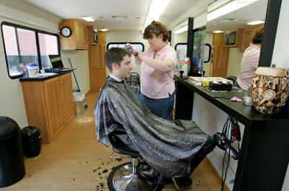
Third Party Payers
(Primarily Advertising)
Advertisers pay for “eyeballs”
    ($29 billion/year at Google)
  Not much for each presentation (pay per impression)
  More for pay per click
  Also: pay per sale (= agency model)
Other third party models
  Government run amenities (e.g. sports fields, libraries)
  Things employers will provide for employees
    Google: Shuttle buses, snacks,
    haircut on-site
Note: mobile salon

Slide 26
Some Pricing Tactics
Tactics are “day-to-day” to implement the strategy
Discounts for buying now
Sales promotion to attract new customers
  Coupons
  Time-limited offers (if you buy before 1 August)
Auctions (especially for surplus inventory)
Two-part pricing
  Concert ticket + “convenience fee”
Yield management
  Variable price, day by day

Slide 27
When the price is “Free”

Slide 28
“Free” is very attractive,
But Revenue has to come from somewhere
Remember Snapchat?
  Procter & Gambel and Ford are the real customers
  Facebook and Google understood this
  Xiami is betting on services income
Expectations that users get everything for free on the Internet
  Resistance to monthly subscriptions
  Fee-based services behind firewalls have not caught on

Slide 29


“Free” as a price Amounts to one of two models:
1. “Freemium”
Economy model is free, draws people to site
Those who want the “classic” version will pay
  Example: SurveyMonkey (limit 100 respondents)
  The free service is a kind of promotion
2. Advertising supported
YouTube is a good example
  Getting eyeballs to the site—then selling them

Slide 30
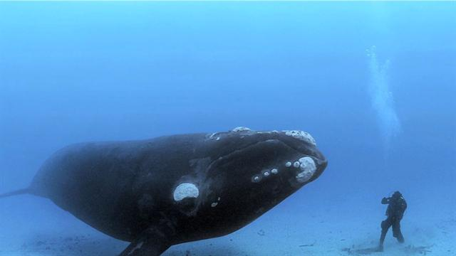

Risks of “Ad Supported”
65%
of digital spending
The “whales” suck all the plankton out of the ocean
  Google
  Facebook
    [Same applies to Baidu & QQ in PRC]
Twitter is a good example of this not-working out
  $80 million/quarter losses continue

Slide 31
Summary on Revenue Streams
If you can’t plan a revenue stream to cover costs you shouldn’t launch
Many Internet businesses over-estimate their ability to be advertising-supported
A “free” offer is highly attractive to customers,
but . . .
There’s no such thing as free
Someone has to pay—there must be a Revenue Stream

Slide 32
Alexa Skill Business
What will people pay for?

